Slide 1

Supreme Court Ruling:
Diversity in Higher Education
Barbara Mistick
President
NAICU
Art Coleman
Managing Partner
EducationCounsel LLC
July 14, 2023

Slide 2


A Moment for Leadership
Now is the time for leadership, not retrenchment.
In the face of new challenges, we have opportunities. Seize them.

Slide 3

Not Legal Advice
Preliminary Analysis…More to Come
The Court’s opinion is complex and our analysis is preliminary, still subject to further refinement.
Nothing in this presentation should be construed as legal advice, which is highly fact- and context-specific. We elevate key points of interpretation and practice as general guidance to consider as you consult with your counsel.

Slide 4
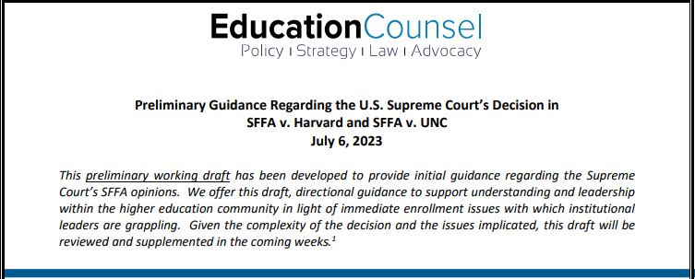
Preliminary Analysis on Which Presentation is Based
https://educationcounsel.com/?publication=educationcounsels-preliminary-guidance-regarding-the-u-s-supreme-courts-decision-in-sffa-v-harvard-and-sffa-v-unc

Slide 5
The Court’s Ruling

Slide 6
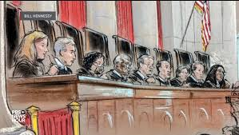
The Top Takeaways
The Educational Benefits of Diversity As Support for Race-Conscious Action
As Asserted, Not Compelling
On Life Support
Race-Neutral Strategies
The New Landscape; Know the Definition
Think Big
Legal Impact
Issue
Practical Direction
Consideration of Race in Admission
Qualities Associated with Individual’s Racial Experience May Be Considered
Racial Status is Prohibited

Slide 7
The Court Ruling
Compelling Interest
The educational benefits of diversity (previously recognized) are no longer compelling to justify race-conscious action.
Too “amorphous” &“elusive.” l Not “sufficiently measurable” or “coherent.”
Negative Effect/Stereotypes
The “classification” of race was “used as a negative” and impermissibly “stereotyped” applicants based on race.
Led to 11% decrease in number of Asian American students admitted.
End Point in Time
Admissions programs “lacked a logical end point.”
Tight percentage bands by race, from year to year implicated “[o]utright racial balancing.”
College admissions are “zero-sum.” l Admission involved “preferences on the basis of race alone”
Process of periodic review isn’t sufficient for satisfying durational requirement; need specific end point to the consideration of racial status
Note: “worthy” and “commendable”

Slide 8
The Court Ruling
Institutional Mission
“Universities may define their mission as they see fit” within broad legal parameters.
Qualities from Student Racial Experience
“[N]othing in this opinion should be construed as prohibiting universities from considering an applicant’s discussion of how race affected his or her life…”
The “touchstone of an individual’s identity [must be with respect to] challenges bested, skills built, or lessons learned”—not the color of their skin.
Significant deference is afforded to higher education institutions on this issue.

Slide 9
What the Court Did Not Expressly Address
Scholarships and Financial Aid
Outreach and Recruitment
Pipeline and Pathways Programs
Data Collection
Employment
Race-Neutral Strategies

Slide 10
Policy and Practice Implications

Slide 11
Back to Basics: Definitions
Race-conscious
Express-Intent-Effect- Individual Benefit
E.g., Fisher II Majority: Texas Top 10% Plan
Race-neutral
Intent-Effect (Often) Broad-based/Inclusive
E.g., General Recruitment & Outreach

Slide 12
How Definitions May Translate
Race-conscious
Involves consideration of applicant’s racial status
Race-neutral
Involves consideration of an individual’s qualities associated with experience relating to race
Other qualities and characteristics like first generation, low income/wealth, etc.

Slide 13

The Race Continuum: The Relevance of Race In Applications
Identity Dependent
“Check the Box”
Racial Status
Race-Neutral, Experience-Related Qualities
Quality associated with experience of race in a person’s own life journey relevant to mission
Race-Neutral Qualities: Subject, Expertise, or Action
Issues of race or equity as subject of actions of commitment or knowledge relevant to mission

Slide 14
Implications: Admissions
Holistic Review
No consideration of racial status
Monitoring Class Composition
Assure complete segregation between information on rolling admissions trends by race and decision-makers involved in holistic review
(Nothing prohibits collection of disaggregated data for research, evaluation, etc. purposes.)
Shaping the Class
Not specifically addressed, but problematic to ‘shape’ class with categorical focus on applicant’s racial status
Consider new models, including identity-neutral DEI factors derived from holistic review analysis
Consideration of mission-aligned skills, knowledge, and character qualities associated with actual student experience of race
Essay Questions
An important avenue to elicit mission-aligned information about skills, knowledge and character qualities

Slide 15
Implications: Financial Aid and Scholarships
Big Picture
Financial aid and scholarship decisions will be informed and shaped by principles in Court’s opinion
But, even there, challenge on racial status-based awards remain: what compelling interest?
Key Strategy
Focus: skills, knowledge, character qualities associated with race
Design Option
For privately endowed scholarships and institutional aid: Pooling and Matching
Arguable distinction: scholarships do not operate as “zero-sum game”
Consider full array of neutral factors and/or adaptation of the “experience associated with race” model for aid awards

Slide 16
Implications: Outreach and Recruitment
Big Picture
The Court’s decision did not address or change what is permissible in terms of recruitment: “Inclusive” programs should remain strategic focus
General Direction
Design Options
Consider clustering similarly focused/designed programs under one “umbrella” with themed components, and with self-selection
The subset of recruitment programs that confer a tangible/material benefits on students may be subject to strict scrutiny
Where selectivity is relevant, consider neutral factors, including qualities associated with experience

Slide 17
Strategies and Action Steps

Slide 18
A Comprehensive Enrollment Policy Evaluation
Pathways
Barriers
E.g.,
Admission
Outreach
Recruitment
Pipeline Programs
Legacy
Early Decision
Test Use
Transfer Policies
Holistic Review
Legally Neutral, DEI Focused Qualities
“Race-Neutral” Strategies
Articulation of Desired Qualities
Authentic
Secondary +DEI Effects
Breadth of Enrollment Policy/Practice
Mission-Focused, Aligned and Integrated

Slide 19
Key Strategies and Action Steps
Policy Decisions
Make changes re: compliance/legal risk and impact
Engagement
Engage early with key stakeholders on directional shifts and expected impact
Research & Data
Documentation
Training
Communications
Ground decisions in institutional experience and general research (key data, trends, projections)
Assure policy clarity regarding any DEI element of policy and practice, with focus on clear distinction between status and experience-related qualities
Develop training materials (guides, tools, power points) that align with/track policy articulation
Assure that key stakeholders know of policy decisions and directions; and all public discussion of policy/practice (including web site) reflects alignment.

Slide 20
Q&A
Jody Feder
Director of Accountability and Regulatory Affairs
NAICU
Jody@NAICU.edu
Art Coleman
Managing Partner
EducationCounsel LLC
art.coleman@educationcounsel.com

